Slide 1
Performance and Optimization opportunities of MPI partitioned communication
Axel Schneewind

Slide 2
Motivation: Hybrid Programming
Rank 0
Rank 1
buffer
?
buffer
p0
p1
p2
p3
p0
p1
p2
p3
T0
T1
T2
T3
T0
T1
T2
T3
Notes:
Motivation:
buffers worked on by multiple threads (pthreads, GPU-threads)
Options for transfer:
single transfer after entire computation -> potentially long waiting time between data being ready and sent
Transfer per rank via Send/Isend/RDMA/... -> contention over resources (network interface) -> locking required
Solution: partititioned communication

Slide 3
Outline
Introduction
MPI partitioned communication
Relevant sections from the MPI-4.1 Standard
Possible performance benefits/optimizations
Benchmarks
Psend vs Blocking/Nonblocking Sends (single-/multithreaded)
Psend, Isend with completion tests
Current implementations in OpenMPI and MPICH
Simple implementation of message aggregation

Slide 4
Outline
Introduction
MPI partitioned communication
Relevant sections from the MPI-4.1 Standard
Possible performance benefits/optimizations
Benchmarks
Psend vs Blocking/Nonblocking Sends (single-/multithreaded)
Psend, Isend with completion tests
Current implementations in OpenMPI and MPICH
Simple implementation of message aggregation

Slide 5
Outline
Introduction
MPI partitioned communication
Relevant sections from the MPI-4.1 Standard
Possible performance benefits/optimizations
Benchmarks
Psend vs Blocking/Nonblocking Sends (single-/multithreaded)
Psend, Isend with completion tests
Current implementations in OpenMPI and MPICH
Simple implementation of message aggregation

Slide 6
Outline
Introduction
MPI partitioned communication
Relevant sections from the MPI-4.1 Standard
Possible performance benefits/optimizations
Benchmarks
Psend vs Blocking/Nonblocking Sends (single-/multithreaded)
Psend, Isend with completion tests
Current implementations in OpenMPI and MPICH
Simple implementation of message aggregation

Slide 7
Outline
Introduction
MPI partitioned communication
Relevant sections from the MPI-4.1 Standard
Possible performance benefits/optimizations
Benchmarks
Psend vs Blocking/Nonblocking Sends (single-/multithreaded)
Psend, Isend with completion tests
Current implementations in OpenMPI and MPICH
Simple implementation of message aggregation

Slide 8
Outline
Introduction
MPI partitioned communication
Relevant sections from the MPI-4.1 Standard
Possible performance benefits/optimizations
Benchmarks
Psend vs Blocking/Nonblocking Sends (single-/multithreaded)
Psend, Isend with completion tests
Current implementations in OpenMPI and MPICH
Simple implementation of message aggregation

Slide 9
MPI: Transfer Mechanisms
Initialization
MPI_Send
MPI_Send_init
MPI_Psend_init
Starting
MPI_Start
MPI_Start
MPI_Pready
MPI_Pready
MPI_Pready
Completion
MPI_Wait
MPI_Wait
Freeing
MPI_Request_free
MPI_Request_free
Transfer phases
Blocking Send
Persistent Send
(similar: Nonblocking Isend)
Partitioned Send
(since MPI-4.0)
Notes:
General sequence of operations on partitioned communication
-> similar to persistent send
-> only MPI_Pready may be called concurrently

Slide 10
Motivation: Hybrid Programming
Rank 0
Rank 1
Send(buffer)
Send(p0); Send(p1)...
PSend(buffer)
...
buffer
buffer
p0
p1
p2
p3
p0
p1
p2
p3
T0
T1
T2
T3
T0
T1
T2
T3
Notes:
Motivation:
buffers worked on by multiple threads (pthreads, GPU-threads)
Options for transfer:
single transfer after entire computation -> potentially long waiting time between data being ready and sent
Transfer per rank via Send/Isend/RDMA/... -> contention over resources (network interface) -> locking required
Solution: partititioned communication

Slide 11
MPI-4.1: Blocking/Nonblocking Send
Order (3.5). Messages are nonovertaking: If a sender sends two messages in succession to the
same destination, and both match the same receive, then this operation cannot receive the
second message if the first one is still pending. [analogously for receive operations]
Order (3.7.4). Nonblocking communication operations are ordered according to the execution
order of the calls that initiate the communication.
Notes:
Important properties of nonblocking communication operations
Nonblocking communication operations are ordered according to the execution
order of the calls that initiate the communication.
The nonovertaking requirement of Section 3.5 is extended to nonblocking communication, with this definition of order being used.
This requirement is not imposed on transfers of partitions

Slide 12
MPI-4.1: Blocking/Nonblocking Send
Order (3.5). Messages are nonovertaking: If a sender sends two messages in succession to the
same destination, and both match the same receive, then this operation cannot receive the
second message if the first one is still pending. [analogously for receive operations]
Order (3.7.4). Nonblocking communication operations are ordered according to the execution
order of the calls that initiate the communication.
Notes:
Important properties of nonblocking communication operations
Nonblocking communication operations are ordered according to the execution
order of the calls that initiate the communication.
The nonovertaking requirement of Section 3.5 is extended to nonblocking communication, with this definition of order being used.
This requirement is not imposed on transfers of partitions

Slide 13
MPI-4.1: Nonblocking Communication Operations
Progress (3.7.4).
A call to MPI_WAIT that completes a receive will eventually terminate and return if a matching send has been started, unless the send is satisfied by another receive. [analogously for sender]
No such requirement for MPI_Start/MPI_Pready!
Similar for completion tests (MPI_Test / MPI_Request_get_status)
Calls to these functions might cause earlier message progress
Notes:
Progress:
Transfers have to be done before MPI_Wait returns or MPI_Test returns flag=true
Transfer has to terminate eventually
No requirement on when exactly transfers occur (MPI_Pready is not required to make progress)
Progress rule also applies to non-destructive testing (MPI_Request_get_status(), MPI_Parrived()) -> could potentially be used to trigger progress earlier
A call to MPI_WAIT that completes a receive will eventually terminate and return if a matching send has been started, unless the send is satisfied by another receive.
In particular, if the matching send is nonblocking, then the receive should complete even if
no call is executed by the sender to complete the send. Similarly, a call to MPI_WAIT that
completes a send will eventually return if a matching receive has been started, unless the
receive is satisfied by another send, and even if no call is executed to complete the receive.

Slide 14
MPI-4.1: Nonblocking Communication Operations
Progress (3.7.4).
A call to MPI_WAIT that completes a receive will eventually terminate and return if a matching send has been started, unless the send is satisfied by another receive. [analogously for sender]
No such requirement for MPI_Start/MPI_Pready!
Similar for completion tests (MPI_Test / MPI_Request_get_status)
Calls to these functions might cause earlier message progress
Notes:
Progress:
Transfers have to be done before MPI_Wait returns or MPI_Test returns flag=true
Transfer has to terminate eventually
No requirement on when exactly transfers occur (MPI_Pready is not required to make progress)
Progress rule also applies to non-destructive testing (MPI_Request_get_status(), MPI_Parrived()) -> could potentially be used to trigger progress earlier
A call to MPI_WAIT that completes a receive will eventually terminate and return if a matching send has been started, unless the send is satisfied by another receive.
In particular, if the matching send is nonblocking, then the receive should complete even if
no call is executed by the sender to complete the send. Similarly, a call to MPI_WAIT that
completes a send will eventually return if a matching receive has been started, unless the
receive is satisfied by another send, and even if no call is executed to complete the receive.

Slide 15
MPI-4.1: Nonblocking Communication Operations
Progress (3.7.4).
A call to MPI_WAIT that completes a receive will eventually terminate and return if a matching send has been started, unless the send is satisfied by another receive. [analogously for sender]
No such requirement for MPI_Start/MPI_Pready!
Similar for completion tests (MPI_Test / MPI_Request_get_status)
Calls to these functions might cause earlier message progress
Notes:
Progress:
Transfers have to be done before MPI_Wait returns or MPI_Test returns flag=true
Transfer has to terminate eventually
No requirement on when exactly transfers occur (MPI_Pready is not required to make progress)
Progress rule also applies to non-destructive testing (MPI_Request_get_status(), MPI_Parrived()) -> could potentially be used to trigger progress earlier
A call to MPI_WAIT that completes a receive will eventually terminate and return if a matching send has been started, unless the send is satisfied by another receive.
In particular, if the matching send is nonblocking, then the receive should complete even if
no call is executed by the sender to complete the send. Similarly, a call to MPI_WAIT that
completes a send will eventually return if a matching receive has been started, unless the
receive is satisfied by another send, and even if no call is executed to complete the receive.

Slide 16
MPI-4.1: Nonblocking Communication Operations
Progress (3.7.4).
A call to MPI_WAIT that completes a receive will eventually terminate and return if a matching send has been started, unless the send is satisfied by another receive. [analogously for sender]
No such requirement for MPI_Start/MPI_Pready!
Similar for completion tests (MPI_Test / MPI_Request_get_status)
Calls to these functions might cause earlier message progress
Notes:
Progress:
Transfers have to be done before MPI_Wait returns or MPI_Test returns flag=true
Transfer has to terminate eventually
No requirement on when exactly transfers occur (MPI_Pready is not required to make progress)
Progress rule also applies to non-destructive testing (MPI_Request_get_status(), MPI_Parrived()) -> could potentially be used to trigger progress earlier
A call to MPI_WAIT that completes a receive will eventually terminate and return if a matching send has been started, unless the send is satisfied by another receive.
In particular, if the matching send is nonblocking, then the receive should complete even if
no call is executed by the sender to complete the send. Similarly, a call to MPI_WAIT that
completes a send will eventually return if a matching receive has been started, unless the
receive is satisfied by another send, and even if no call is executed to complete the receive.

Slide 17
MPI-4.1: Partitioned Communication
Rationale. Partitioned communication is designed to provide opportunities for MPI implementations to optimize data transfers.
MPI is free to choose how many transfers to do within a partitioned communication send independent of how many partitions are reported as ready to MPI through MPI_PREADY calls.
Aggregation of partitions is permitted but not required.
Ordering of partitions is permitted but not required.
A naive implementation can simply wait for the entire message buffer to be marked ready before any transfer(s) occur and could wait until the completion function is called on a request before transferring data. [...]. (End of rationale.)
Notes:
TODO: shorten
Standard names possible optimizations that implementations may perform:
Aggregation
Reordering
Selecting internal message size different to counts given to Psend/recvInit()
Implementation may decide when to perform transfers

Slide 18
MPI-4.1: Partitioned Communication
Rationale. Partitioned communication is designed to provide opportunities for MPI implementations to optimize data transfers.
MPI is free to choose how many transfers to do within a partitioned communication send independent of how many partitions are reported as ready to MPI through MPI_PREADY calls.
Aggregation of partitions is permitted but not required.
Ordering of partitions is permitted but not required.
A naive implementation can simply wait for the entire message buffer to be marked ready before any transfer(s) occur and could wait until the completion function is called on a request before transferring data. [...]. (End of rationale.)
Notes:
TODO: shorten
Standard names possible optimizations that implementations may perform:
Aggregation
Reordering
Selecting internal message size different to counts given to Psend/recvInit()
Implementation may decide when to perform transfers

Slide 19
MPI-4.1: Partitioned Communication
Rationale. Partitioned communication is designed to provide opportunities for MPI implementations to optimize data transfers.
MPI is free to choose how many transfers to do within a partitioned communication send independent of how many partitions are reported as ready to MPI through MPI_PREADY calls.
Aggregation of partitions is permitted but not required.
Ordering of partitions is permitted but not required.
A naive implementation can simply wait for the entire message buffer to be marked ready before any transfer(s) occur and could wait until the completion function is called on a request before transferring data. [...]. (End of rationale.)
Notes:
TODO: shorten
Standard names possible optimizations that implementations may perform:
Aggregation
Reordering
Selecting internal message size different to counts given to Psend/recvInit()
Implementation may decide when to perform transfers

Slide 20
Possible performance benefits – Less locking overhead
Thread 1
Thread 2
Thread 3
MPI_Send()
MPI_Send()
MPI_Send()
Network devices
Pready not required to interact with network devices
Can be called concurrently
Notes:
TODO
Transfers per thread might require synchronization of accesses to network interface
Psend: only mark partitions as ready when calling Pready and handle transfer somewhere else (e.g. main thread)

Slide 21
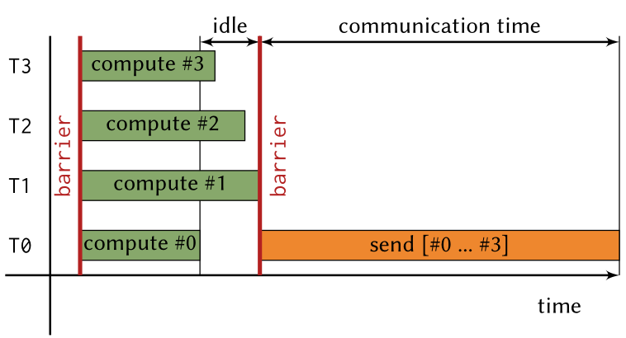
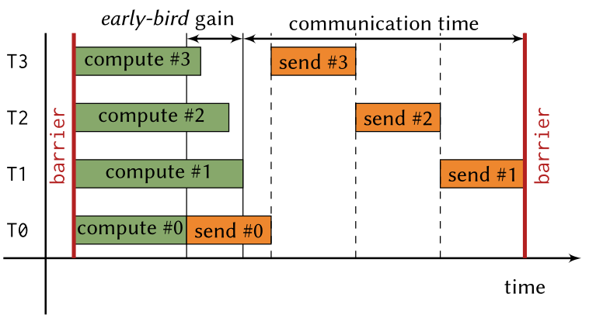
Possible performance benefits – Early-bird effect
Single transfer for entire buffer
One transfer per partition
Thomas Gillis, Ken Raffenetti, Hui Zhou, Yanfei Guo, and Rajeev Thakur. 2023.
Quantifying the Performance Benefits of Partitioned Communication in MPI.
Notes:
TODO: insert graphic
Idea:
Starting transfer as soon as first partition is ready overlaps computation and communication,
Reduces total time from start of computation to end of communication, especially if duration between first and last partition becoming ready is large

Slide 22
Possible optimization – Message aggregation
R0
R1
R0
R1
Pready
Pready
Pready
overhead
Pready
overhead
m1
overhead
m1 + m2
overhead
m2
overhead
overhead
Notes:
LogG model:
(communication latency (L), overhead(o), bandwidth (G), gap (g))
There is some duration g between consecutive messages, where earlier transfer does not increase effective bandwidth
Implementations may wait before sending after Pready calls without reducing effective bandwidth

Slide 23
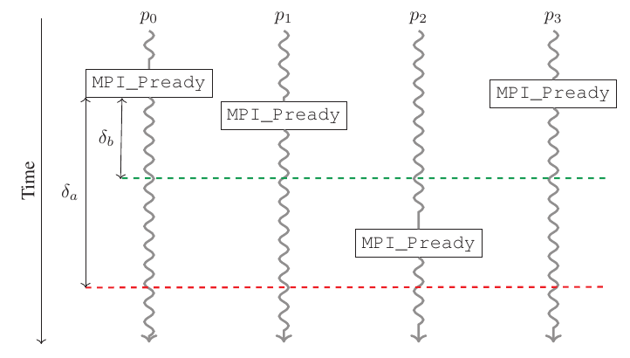
Possible optimization – Message aggregation
Y. H. Temuçin, S. Levy, W. Schonbein, R. E. Grant and A. Afsahi, "A Dynamic Network-Native MPI Partitioned Aggregation Over InfiniBand Verbs,"
https://doi.org/10.1109/CLUSTER52292.2023.00029
Notes:
How transfer could work:
Send message after each Pready
Wait for last Pready and send entire buffer
Potentially better: after p0, wait for some delta and send both p0,p1, then p3, then p2
Only 3 messages transferred

Slide 24
Benchmarks: Goals
Measure effective bandwidth depending on
Partition size
Transfer mechanism
Order of partitions being marked as ready
Usage of completion tests to trigger earlier message progress
MPI-implementation: OpenMPI, (MPICH)

Slide 25
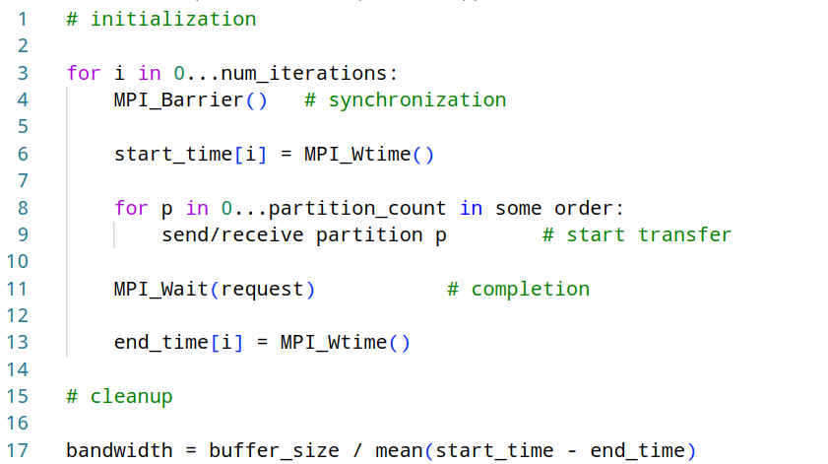
Benchmarking scheme
Notes:
TODO: Pseudocode schöner anzeigen
// initialization
for i in 0...num_iterations:
MPI_Barrier(); // synchronization
s_i = MPI_Wtime();
MPI_Start(&request);
for p in 0...partition_count in some order:
perform some MPI operation to send/receive partition p
MPI_Wait(&request, &result->send_status);
e_i = MPI_Wtime();
// cleanup

Slide 26
Transfer mechanisms
Mechanism | Initialization | Partition ready | Completion | Freeing
Send | - | MPI_Send (p) | - | -
SendPersistent | MPI_Send_init (p) | MPI_Start (p) | MPI_Waitall | MPI_Request_free (p)
Isend | - | MPI_Isend (p) | MPI_Waitall | MPI_Request_free (p)
Psend | MPI_Psend_init | MPI_Pready (p) | MPI_Wait | MPI_Request_free
operations marked with (p) are performed for each partition

Slide 27
Experimental setup
2 nodes on HAWK with one MPI process each
Max. Bandwidth: 200Gbit/s = 25GB/s
Buffer size: 8MiB
Partition sizes: 512B, 1024B, ..., 8MiB
Partitions marked ready in different orders:
Left-to-right
Randomized
Neighbourhood exchange pattern
Multithreading with OpenMP
Notes:
TODO: exact maximum bandwidth for Infiniband
OpenMPI uses ucx as as P2P-Messaging Layer per default

Slide 28
Experimental setup
2 nodes on HAWK with one MPI process each
Max. Bandwidth: 200Gbit/s = 25GB/s
Buffer size: 8MiB
Partition sizes: 512B, 1024B, ..., 8MiB
Partitions marked ready in different orders:
Left-to-right
Randomized
Neighbourhood exchange pattern
Multithreading with OpenMP
Notes:
TODO: exact maximum bandwidth for Infiniband
OpenMPI uses ucx as as P2P-Messaging Layer per default

Slide 29
Experimental setup
2 nodes on HAWK with one MPI process each
Max. Bandwidth: 200Gbit/s = 25GB/s
Buffer size: 8MiB
Partition sizes: 512B, 1024B, ..., 8MiB
Partitions marked ready in different orders:
Left-to-right
Randomized
Neighbourhood exchange pattern
Multithreading with OpenMP
Notes:
TODO: exact maximum bandwidth for Infiniband
OpenMPI uses ucx as as P2P-Messaging Layer per default

Slide 30
Experimental setup
2 nodes on HAWK with one MPI process each
Max. Bandwidth: 200Gbit/s = 25GB/s
Buffer size: 8MiB
Partition sizes: 512B, 1024B, ..., 8MiB
Partitions marked ready in different orders:
Left-to-right
Randomized
Neighbourhood exchange pattern
Multithreading with OpenMP
Notes:
TODO: exact maximum bandwidth for Infiniband
OpenMPI uses ucx as as P2P-Messaging Layer per default

Slide 31
Experimental setup
2 nodes on HAWK with one MPI process each
Max. Bandwidth: 200Gbit/s = 25GB/s
Buffer size: 8MiB
Partition sizes: 512B, 1024B, ..., 8MiB
Partitions marked ready in different orders:
Left-to-right
Randomized
Neighbourhood exchange pattern
Multithreading with OpenMP
Notes:
TODO: exact maximum bandwidth for Infiniband
OpenMPI uses ucx as as P2P-Messaging Layer per default

Slide 32
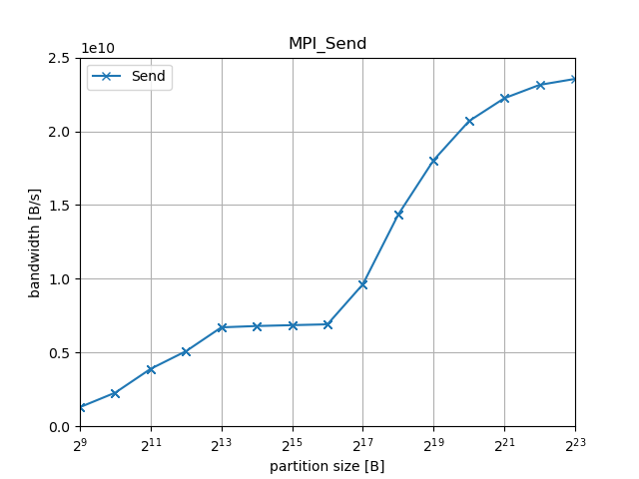
Results: Blocking Send

Slide 33
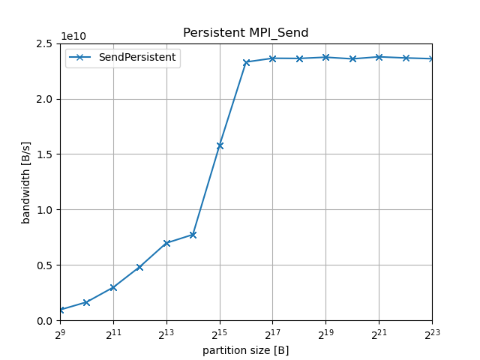
Results: Persistent Send
Notes:
Speedup compared to Send/Recv, as transfer and initialization of next transfer can happen concurrently

Slide 34
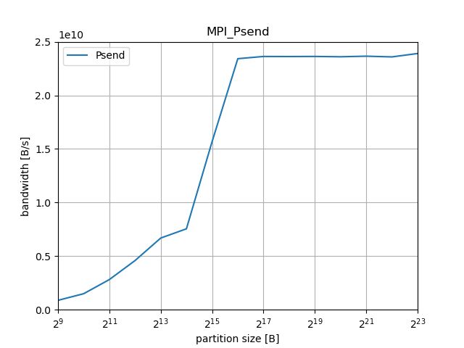
Results: Psend
Notes:
Similar to Isend/Irecv or persistent Send

Slide 35
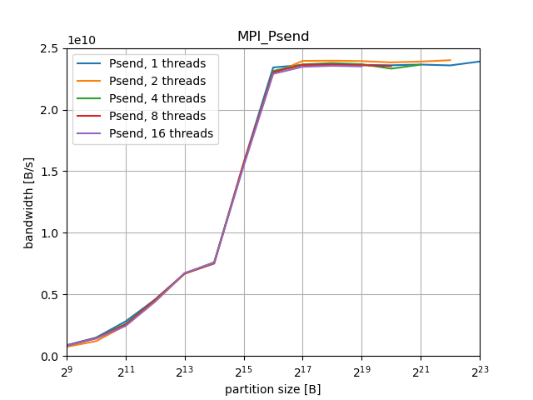
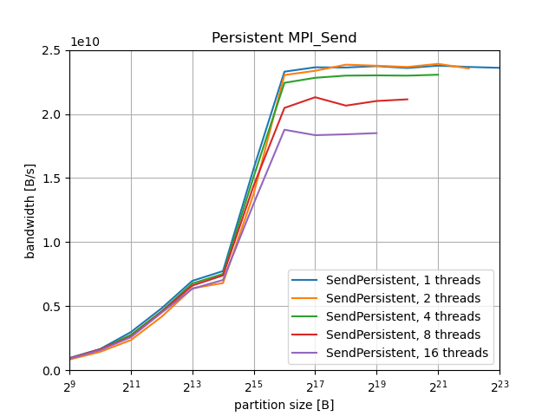
Results: Persistent Send vs Psend (multithreaded)
Notes:
Bandwidth differs by ~10% for higher partition sizes, possibly due to no required synchronization on Pready calls

Slide 36
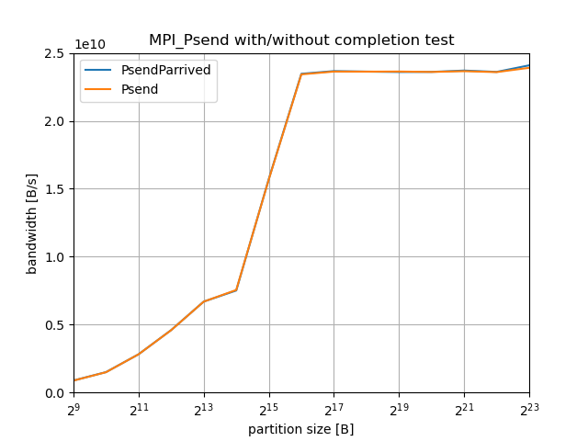
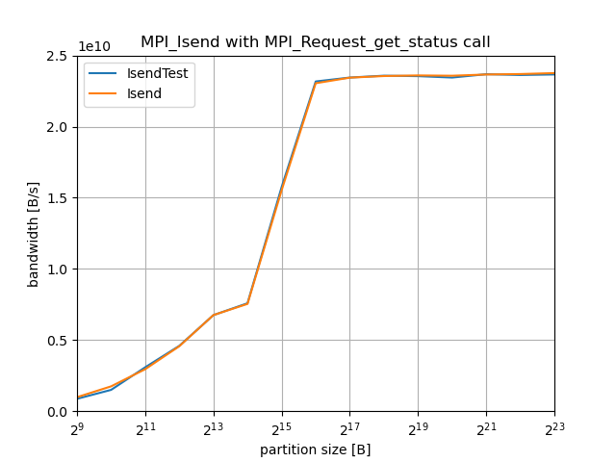
Results: Completion Testing
Receive-Side completion test with MPI_Parrived
Send-Side completion testing with MPI_Request_get_status crashes program
Notes:
TODO: compare isend with/without on fixed thread count
Bandwidth differs by ~10% for higher partition sizes, possibly due to no required synchronization on Pready calls

Slide 37
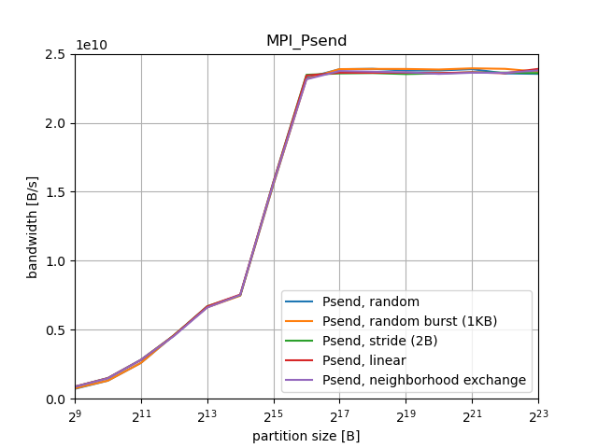
Results: Psend with different send patterns
Notes:
Bandwidth differs by ~10% for higher partition sizes, possibly due to no required synchronization on Pready calls

Slide 38
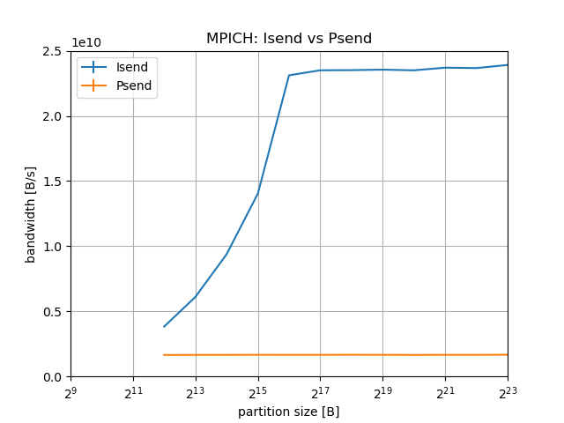
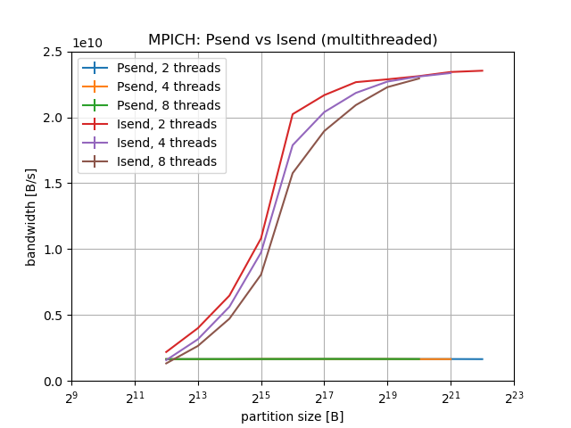
Results: Psend on MPICH-4.1.2

Slide 39
Current implementations: OpenMPI/5.0.2
MPI_Start():
for p in 0...partition_count-1:
flag[p] = 0;
MPI_Psend_init
MPI_Start
MPI_Pready(p):
flag[p] = 1;
MPI_Pready
MPI_Pready
MPI_Pready
progress():
for p with flag[p] == 1:
isend(request[p]);
flag[p] = 2;
MPI_Wait/MPI_Test
MPI_Request_free
Notes:
MPICH maps all partitions to one single transfer:
Counter initialized with partition count in MPI_Start
Pready decrements counter
When counter == 0: start transfer

Slide 40
Current implementations: MPICH/4.2.0
MPI_Psend_init
MPI_Start():
counter = partition_count;
MPI_Start
MPI_Pready
MPI_Pready
MPI_Pready():
counter—;
if counter == 0:
send(buffer);
MPI_Pready
MPI_Wait/MPI_Test
MPI_Request_free
Notes:
MPICH maps all partitions to one single transfer:
Counter initialized with partition count in MPI_Start
Pready decrements counter
When counter == 0: start transfer

Slide 41
Naive method of message aggregation
Public partitions:
map m partitions to 1 internal partition
Internal partitions:
counters:
0 | 0 | 0 | 0 | 0 | 0 | 0 | 0
Pready(p):
increment counter of internal partition of p
if counter >= m:
mark internal partition as ready

Slide 42
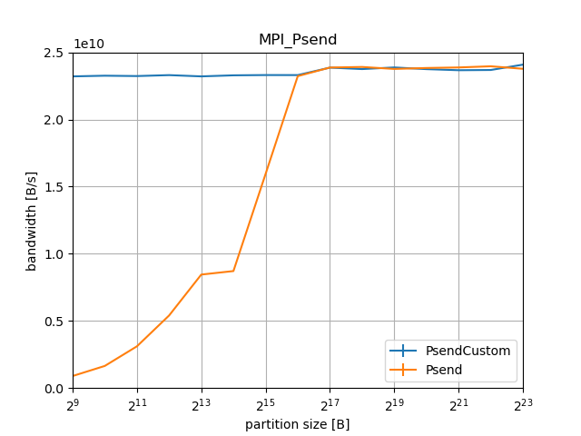
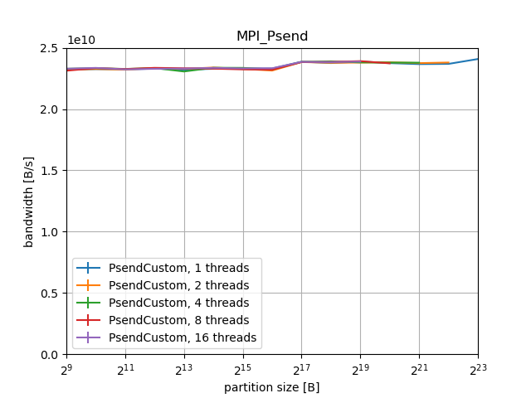
Results: Naive message aggregation
Notes:
TODO

Slide 43
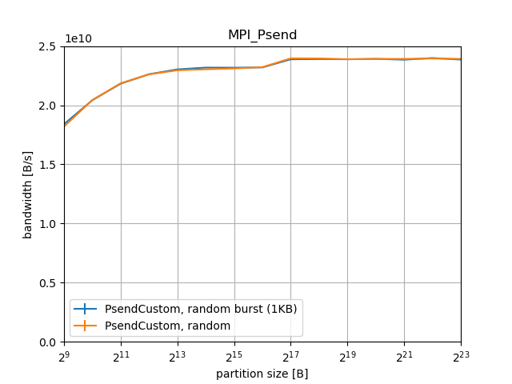
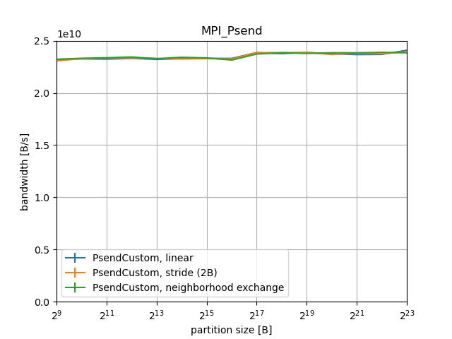
Results: Naive message aggregation
Notes:
TODO

Slide 44
Conclusion
OpenMPI:
Psend performs similar to persistent Send when single-threaded
Psend performs better when using multiple threads
Psend implemented using nonblocking sends
Currently no further optimizations such as message aggregation
Send pattern does not influence performance
MPICH:
Psend implemented by performing single transfer after all Pready-calls
Psend performs worse than other mechanisms
Message aggregation:
Mapping partitions to larger messages can improve performance

Slide 45
Thanks for your attention!

Slide 46
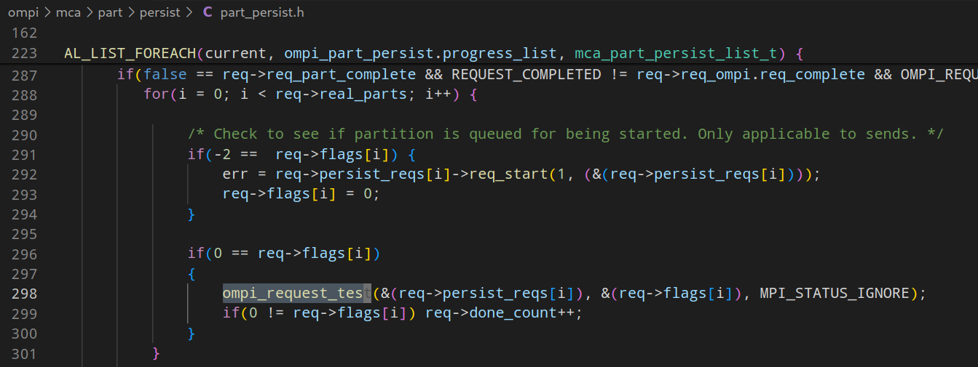
Appendix – OpenMPI progress

Slide 47
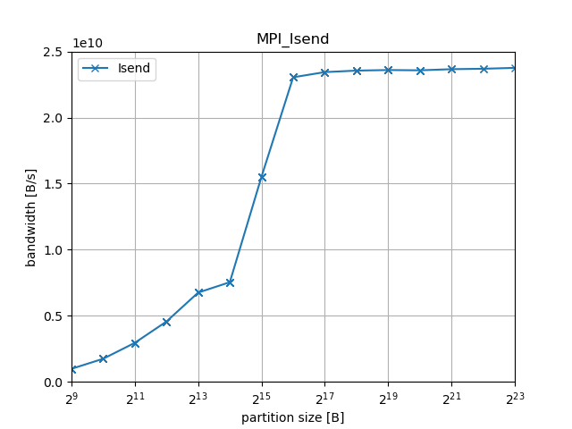
Isend
Notes:
Speedup compared to Send/Recv, as transfer and initialization of next transfer can happen concurrently

Slide 48
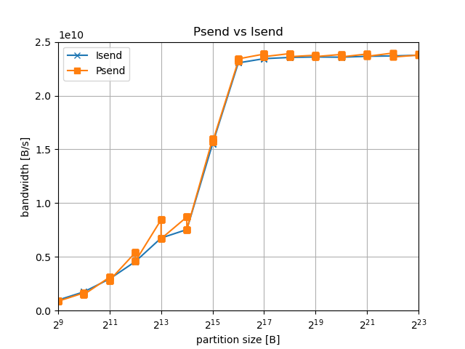
Isend vs Psend

Slide 49
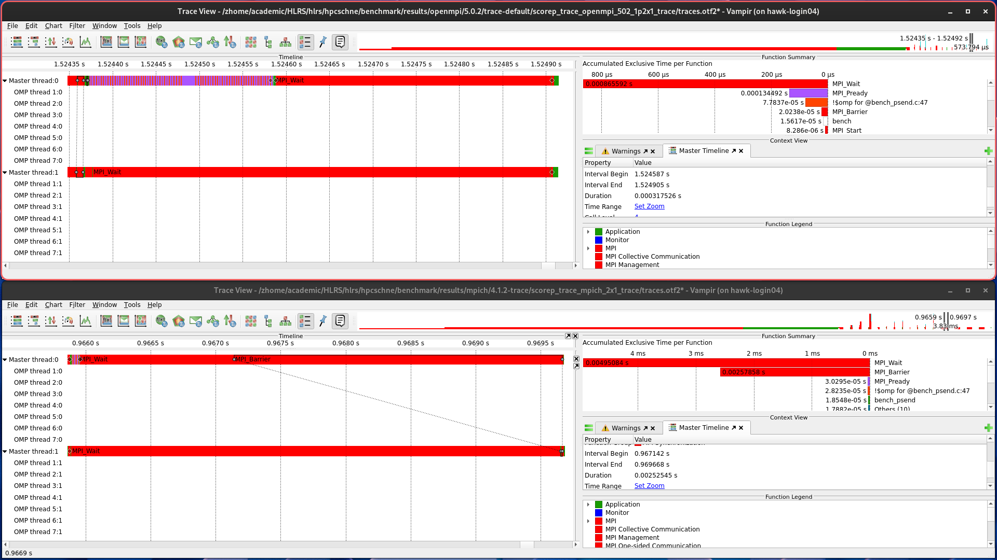
Traces: MPI_Psend

Slide 50
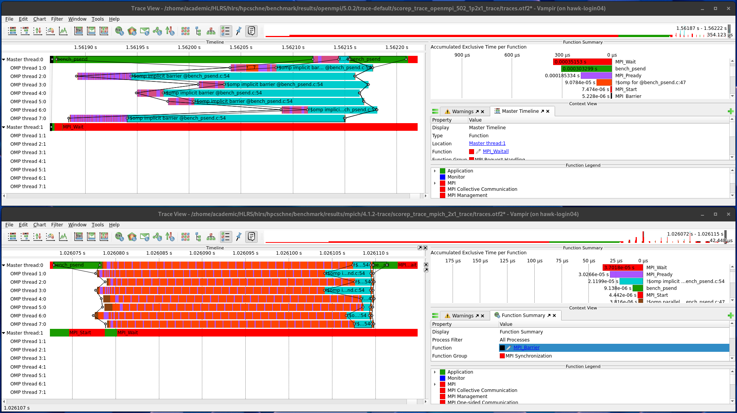
Traces: MPI_Psend – MPI_Pready-Calls

Slide 51
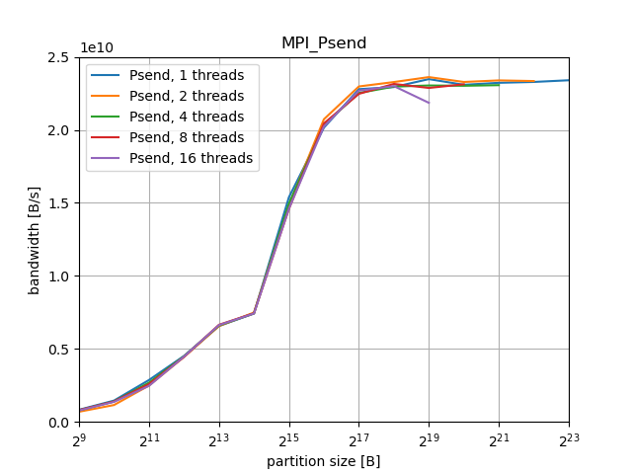
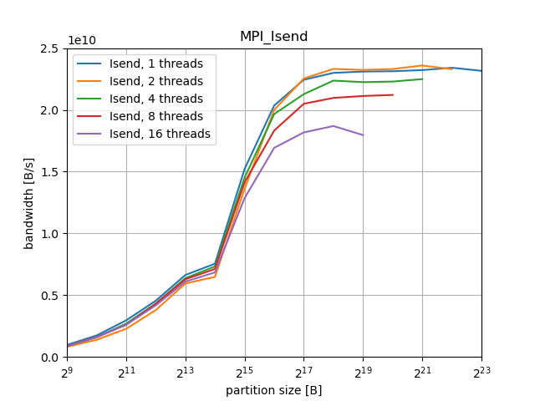
Appendix: Isend vs Psend (multithreaded)
Notes:
Bandwidth differs by ~10% for higher partition sizes, possibly due to no required synchronization on Pready calls

Slide 52
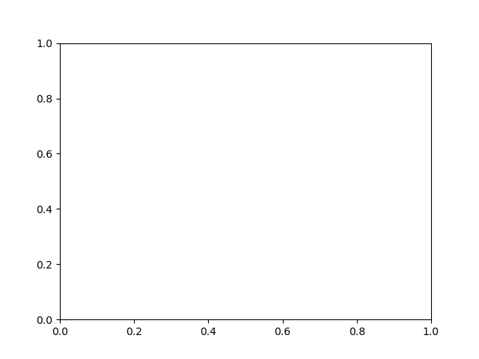
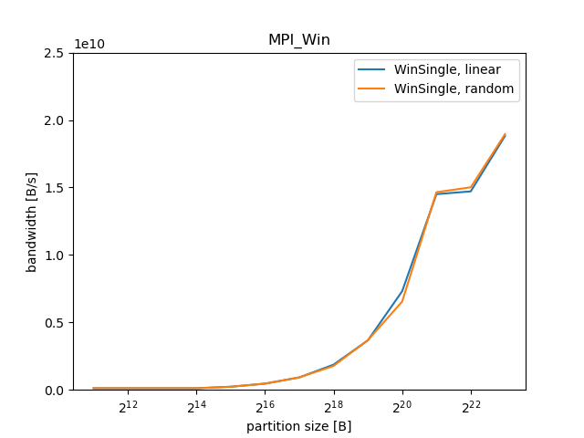
Results: MPI_Win
Notes:
TODO update, include multithreaded case, compare to Psend

